Slide 1
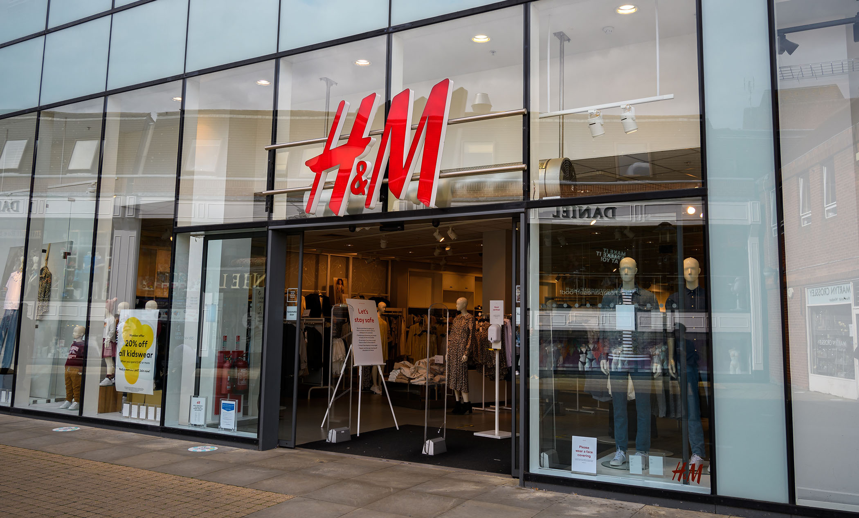
An Analytical Study on H&M Sales Data

Slide 2

About the H&M Dataset
Hennes & Mauritz AB or H&M Group is a multinational clothing company based in Sweden. Its focus is fast-fashion clothing for men, women, teenagers, and children. As of 2021, H&M Group operates in 75 geographical markets with 4,702 stores under the various company brands, with 107,375 full-time equivalent positions.
The dataset contains records for the H&M product sales across various cities, states and regions of United States for the year 2018. It consists of 99 rows and 15 columns.

Slide 3
Problem Statement
H&M is the world’s second-largest apparel shop, known for its fast-fashion items. The company operates in around 60 countries and has a strong internet presence. H&M is at a leading position in its respective sector and it thrives to maintain its position by providing best products to its customers as per their taste also in the days to come.

Slide 4
Factors Determining the Sales and Profit
CITY
STATE
REGION
QUARTER
CATEGORY and SUB-CATAGORY
SHIPPING MODE

Slide 5
Key Objectives (using Dashboard Analysis)
Which region of the country accounts for the highest sales?
Which quarter records the highest sales?
Which category of product accounts for the maximum sales?
Which Ship Mode Records the highest sales?

Slide 6
Key Objectives (using Dashboard Analysis) Cont.
Which region extracts the highest profit?
Which category of product extracts the maximum profit?
Which Quarter accounts for the maximum profit?
Which Sub-category of product accounts for maximum unit sales?

Slide 7
Key Objectives (using Conditional Formatting)
Which state records the highest sales?
Which city records the highest sales?
Which state records the highest profit?
Which city records the highest profit?

Slide 8
Key Findings (using Dashboard Analysis)
Standard Class accounts for the highest % of Sales.
Footwear records the highest sales.
The region with the highest sales is West.
The Fourth Quarter gives the highest sales.
Again Footwear accounts for the highest profit.
Northern Region gives the highest profit.
Second Quarter records for the highest profit.
Dresses records the maximum unit sell.

Slide 9
Key Findings (using Conditional Formatting)
The City of Philadelphia in the state of Pennsylvania accounts for the highest sales for Flip flops under the Footwear Category.
New York city records the highest profit for bags under the Accessories Category in the state of New York.

Slide 10
THANK YOU

